Slide 1
Image Processing

Slide 2
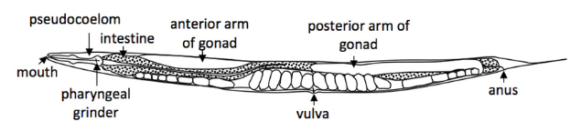
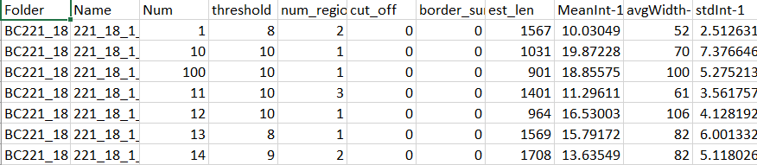
Overview
Ground Truth
Worm Image
Feature Extraction
Feature Exploration
Feature Selection
PCA and Heat Maps
LDA, Lasso, Stepwise Logistic Regression

Slide 3
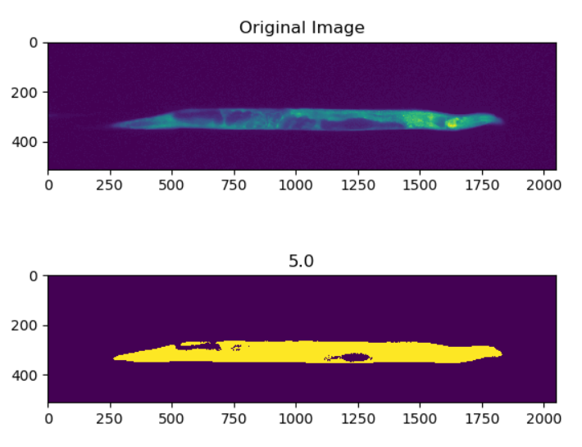
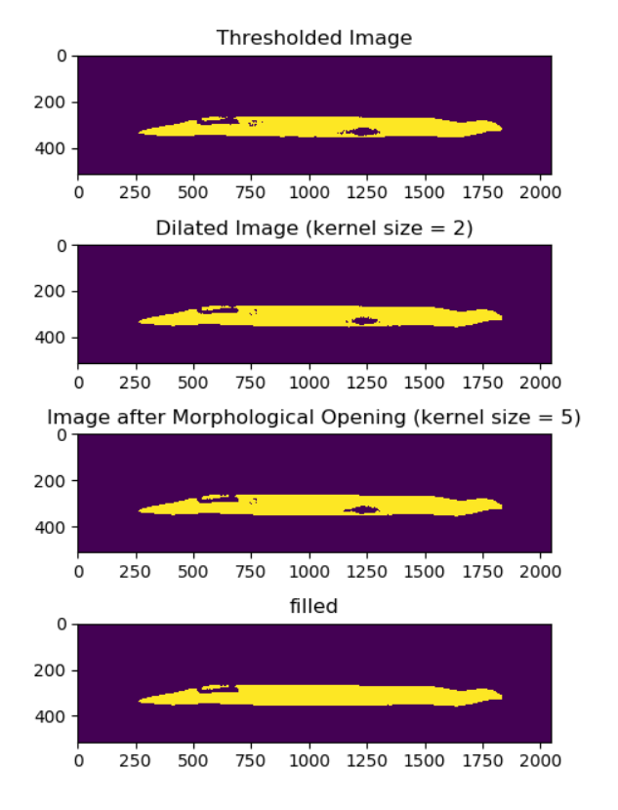
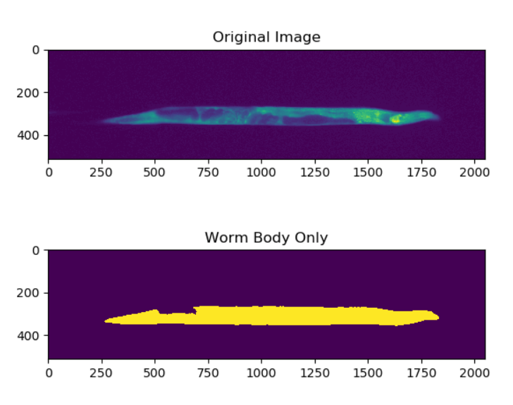
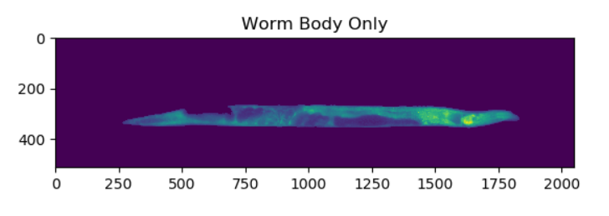
Feature Extraction
List of features we wanted to look at, how we determined those features
Worm Image

Slide 4
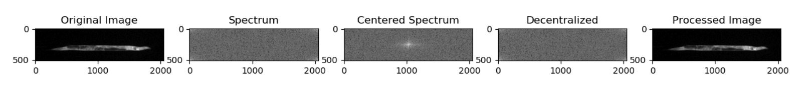
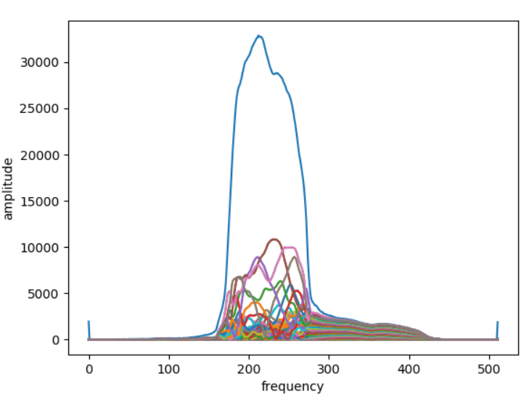
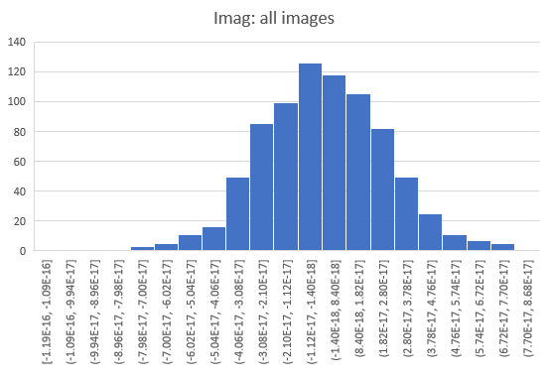
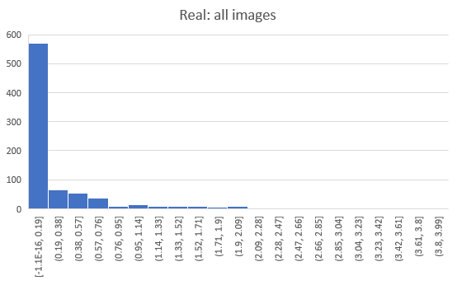
Feature Extraction
Fourier transformation preliminary
FFT for single worm image
Notes:
Done along columns (x-axis) because that’s where we would expect the most differences

Slide 5
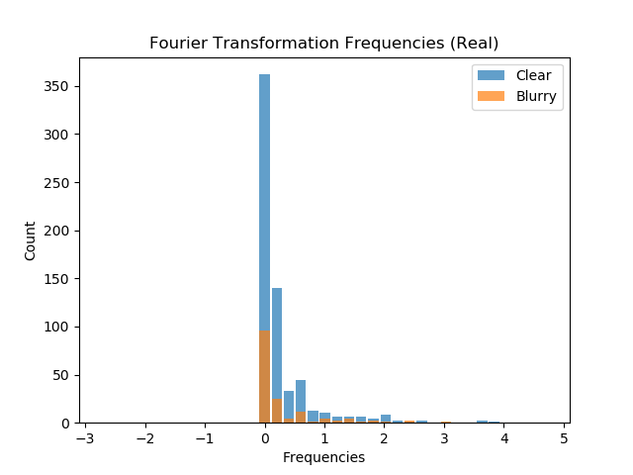
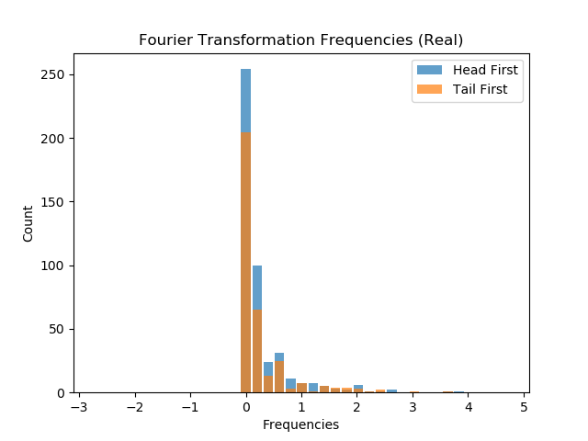
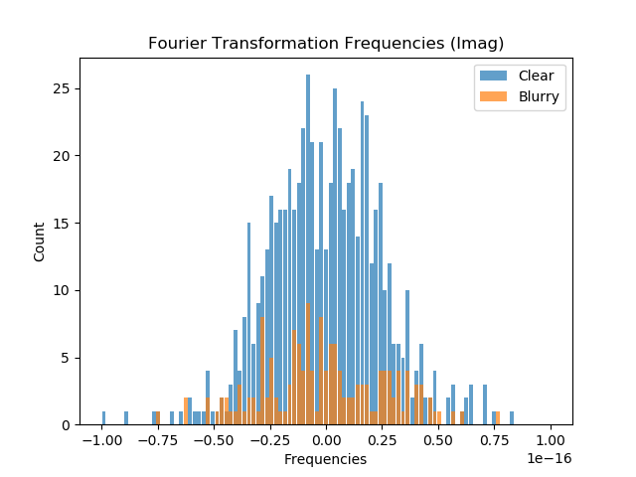
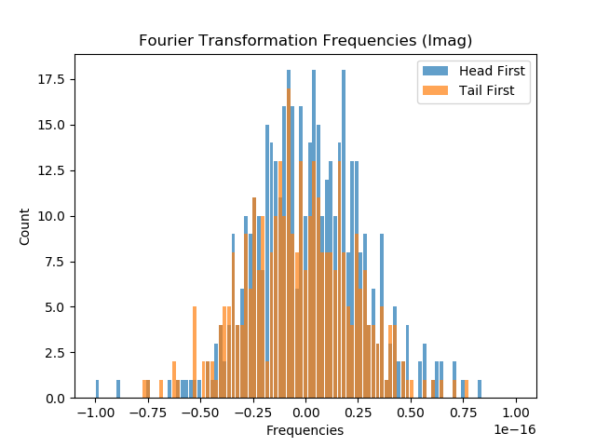
Feature Extraction
Fourier Frequency

Slide 6
Feature Exploration: Correlation

Slide 7
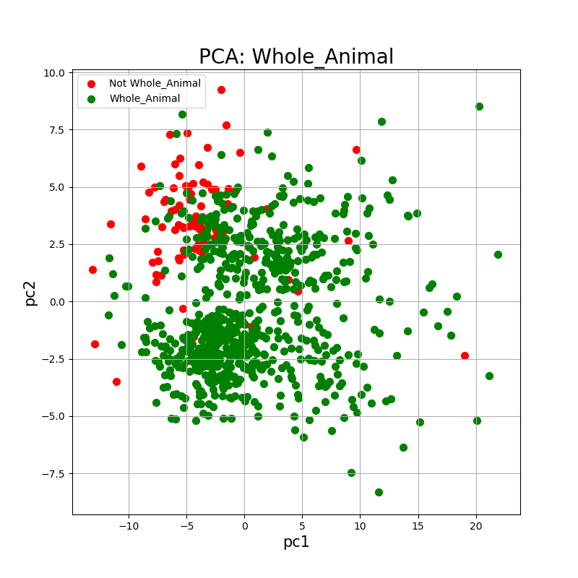
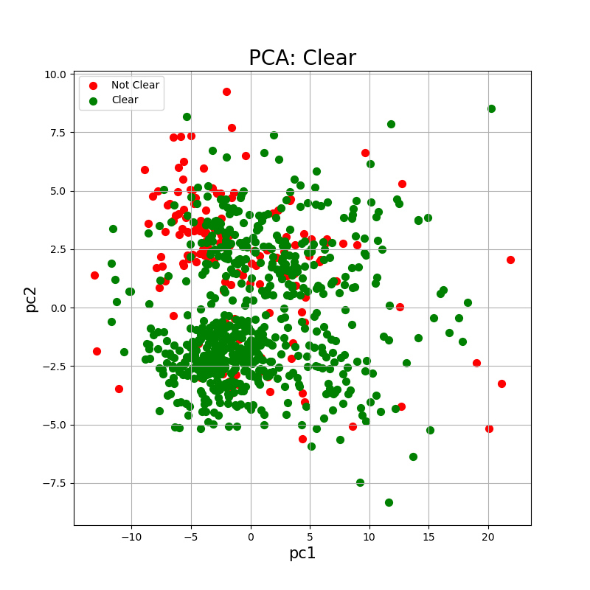
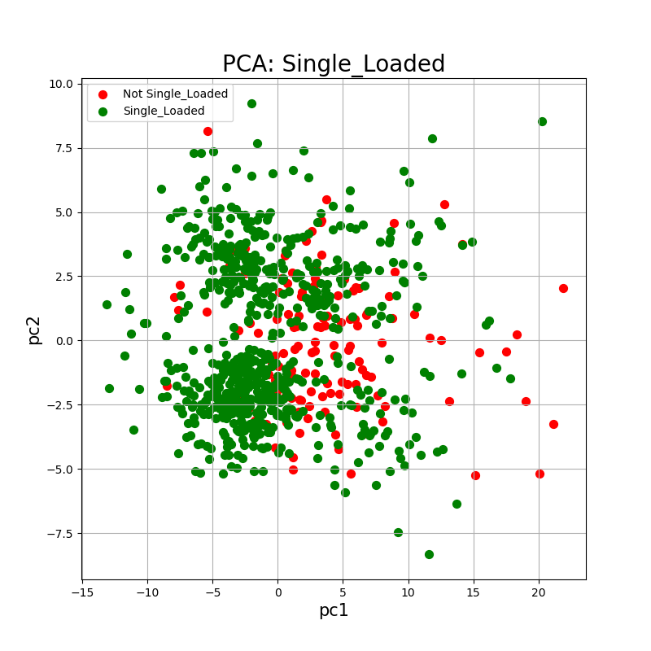
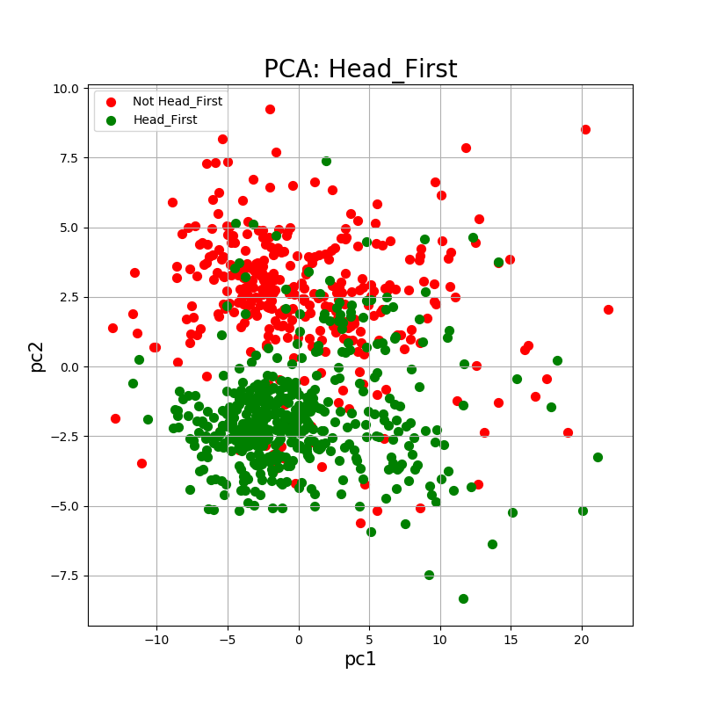
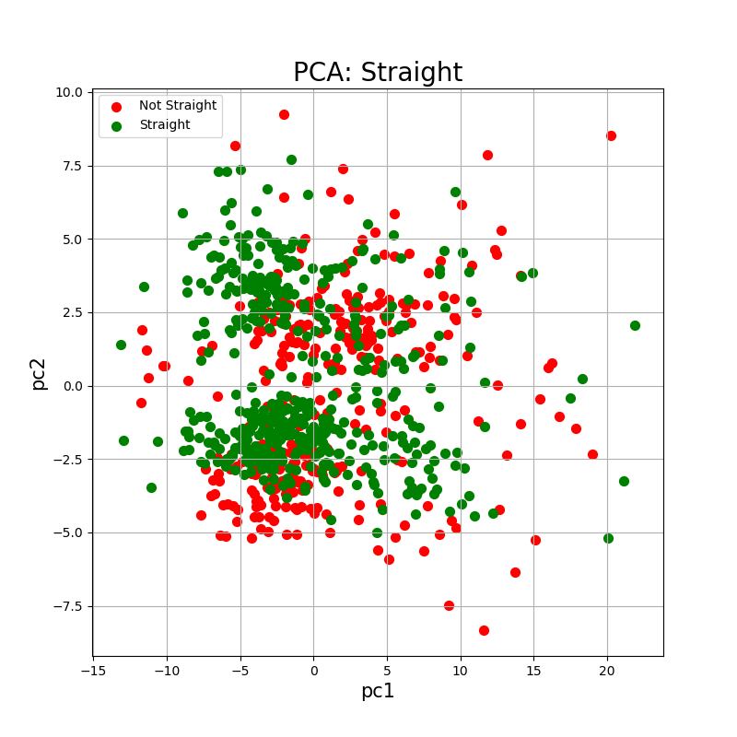
Feature Exploration: PCA
PCA with pc1 and pc2 for each feature

Slide 8
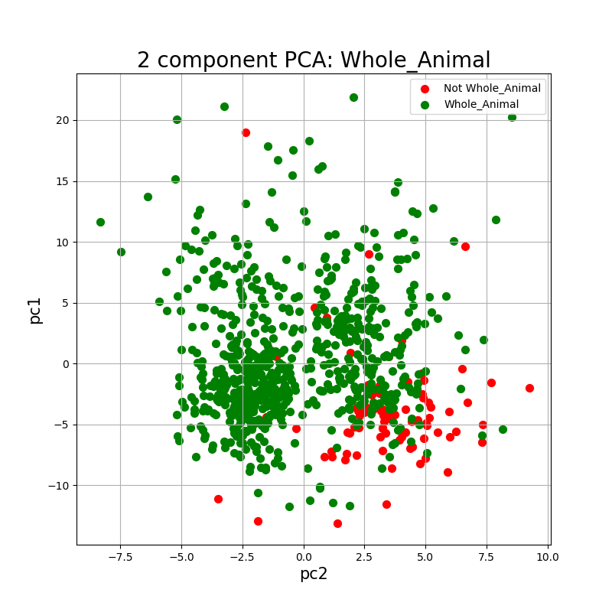
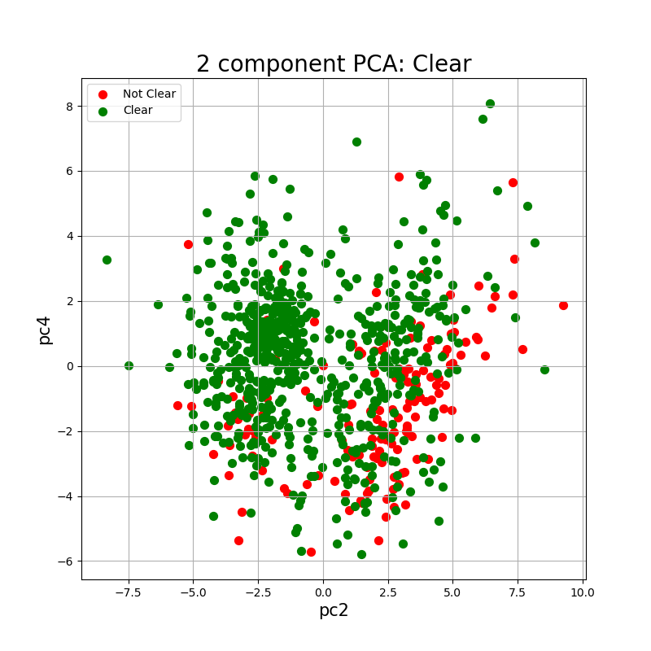
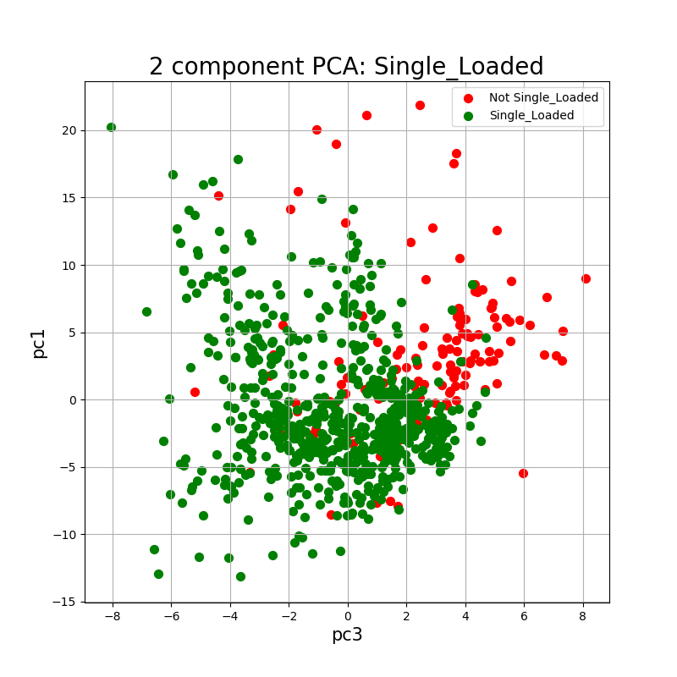
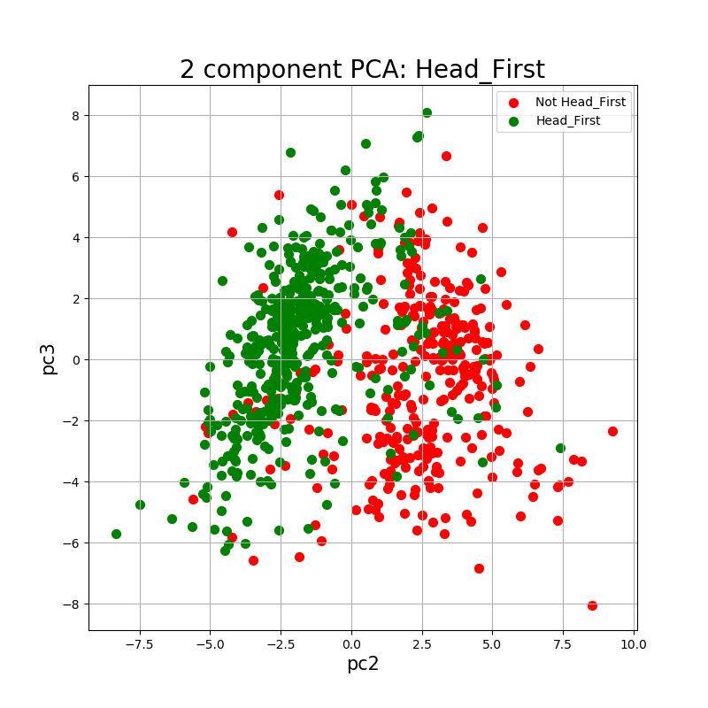
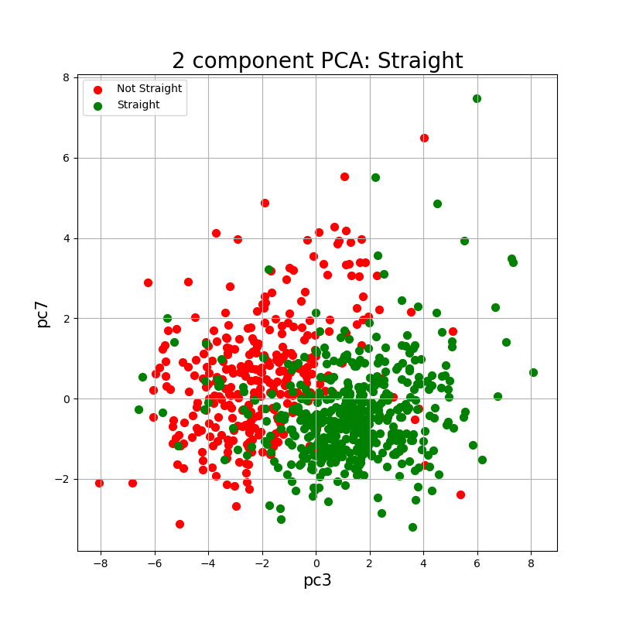
Feature Exploration: PCA
PCA with most highly correlated pcs
PCA on all data where n_components = 8-10
Not much better than just doing pc1/pc2 for everything
Notes:
Whole_animal: pc2/1
Clear: pc2/4
Single_Loaded: pc3/1
Head_First: pc2/3
Straight: pc3/7
Features: Num threshold num_regions est_len MeanInt-1 avgWidth-1 stdInt-1 perct95-1 medianInt-1 sumInt-1 MeanInt-2 avgWidth-2 stdInt-2 perct95-2 medianInt-2 sumInt-2 MeanInt-3 avgWidth-3 stdInt-3 perct95-3 medianInt-3 sumInt-3 MeanInt-4 avgWidth-4 stdInt-4 perct95-4 medianInt-4 sumInt-4 MeanInt-5 avgWidth-5 stdInt-5 perct95-5 medianInt-5 sumInt-5 MeanInt-6 avgWidth-6 stdInt-6 perct95-6 medianInt-6 sumInt-6 MeanInt-7 avgWidth-7 stdInt-7 perct95-7 medianInt-7 sumInt-7 MeanInt-8 avgWidth-8 stdInt-8 perct95-8 medianInt-8 sumInt-8 MeanInt-9 avgWidth-9 stdInt-9 perct95-9 medianInt-9 sumInt-9 MeanInt-10 avgWidth-10 stdInt-10 perct95-10 medianInt-10 sumInt-10 aspect_ratio intRatio2-9 tipWidthRatio BodMeanInt BodAvgWidth BodStdInt BodPerct95 BodMedianInt BodSumInt BKMeanInt

Slide 9
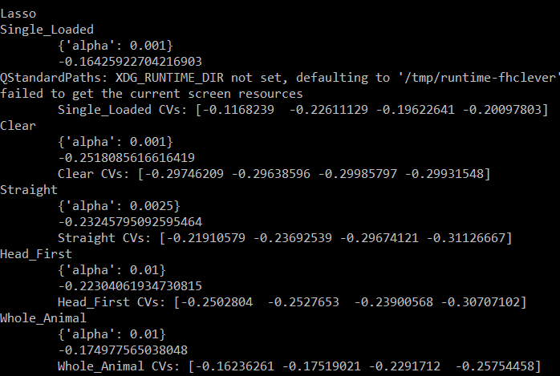
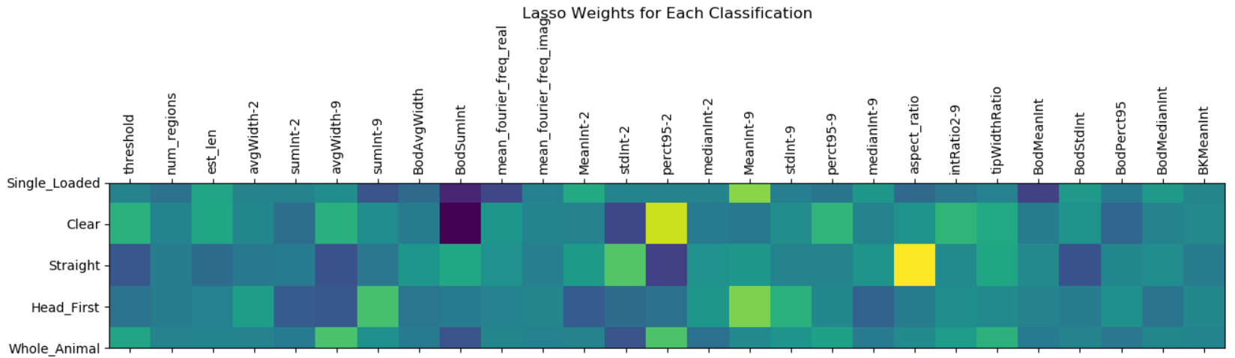
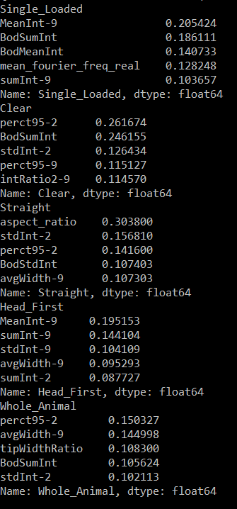
Feature selection
Lasso
Notes:
Use GridSearchCV to test different alpha values (or different anything, really – quite a handy tool!)

Slide 10
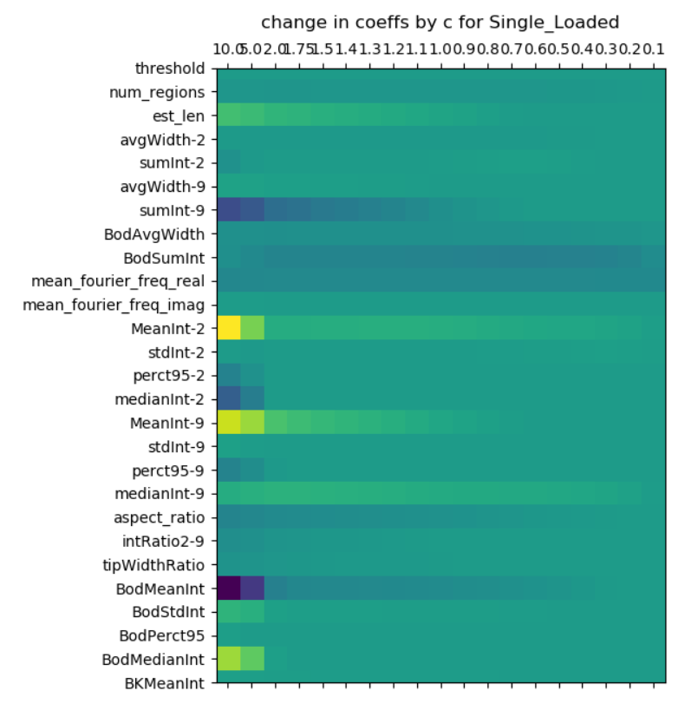
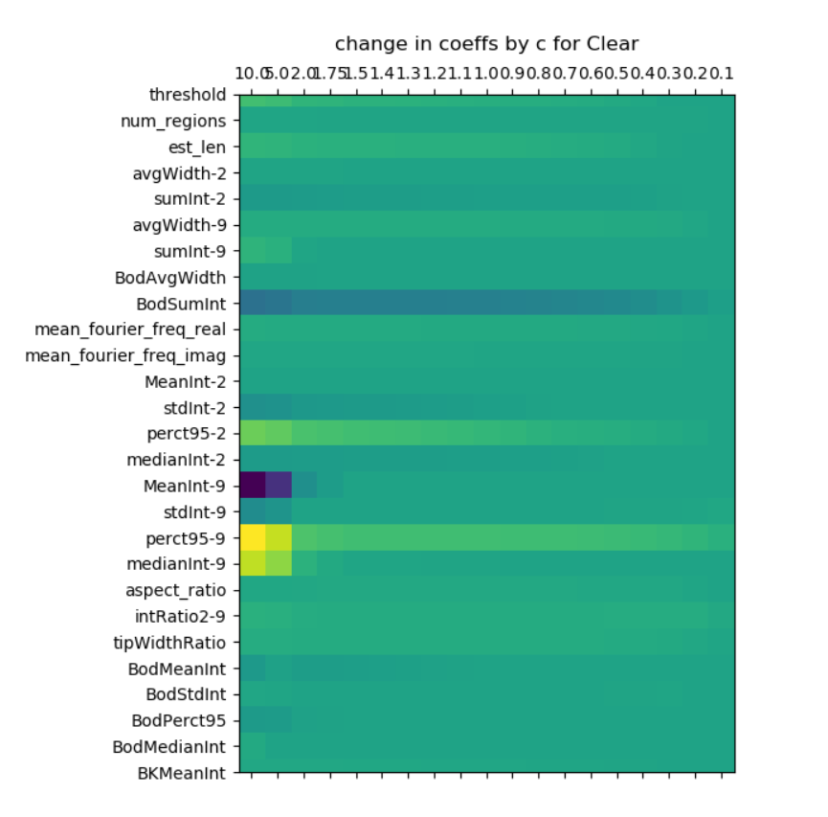
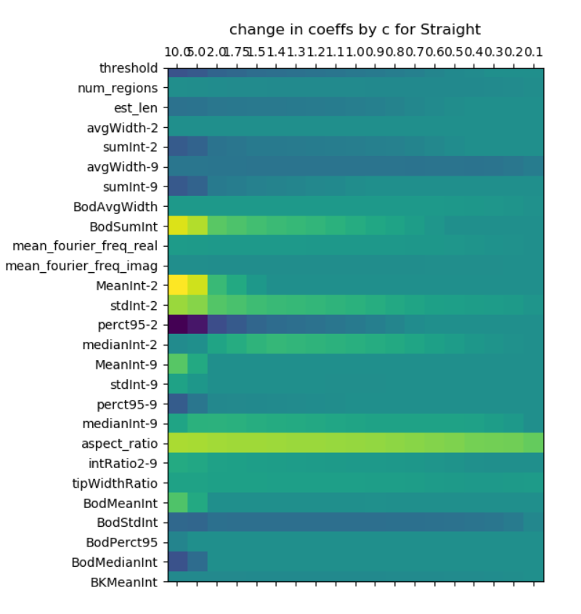
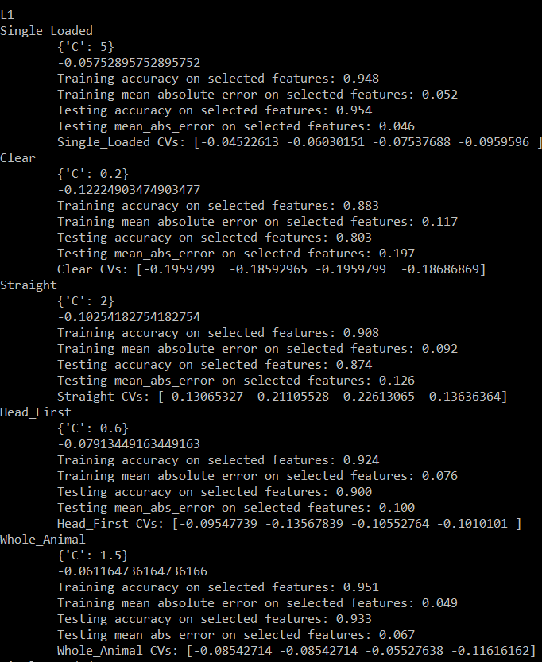
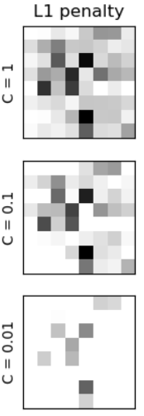
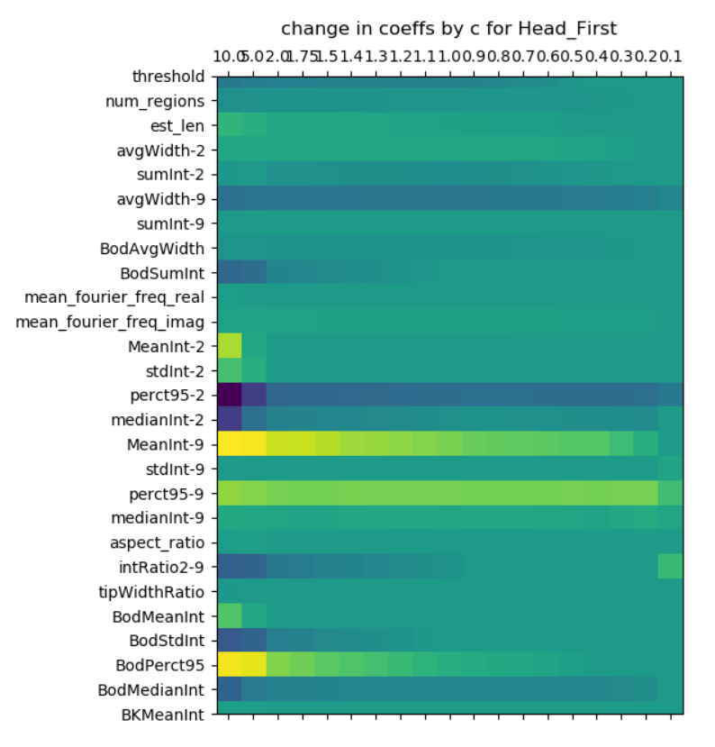
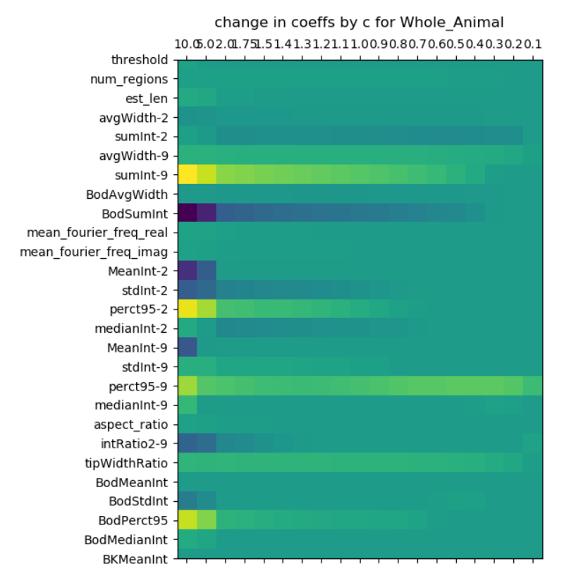
Feature Selection
L1 logistic regression
C = [10, 5, 2, 1.75, 1.5, 1.4, 1.3, 1.2, 1.1, 1, .9, .8, .7, .6, .5, .4, .3, .2, .1]
Notes:
B&W Image from https://scikit-learn.org/stable/auto_examples/linear_model/plot_logistic_l1_l2_sparsity.html
Looks like when you get the C value very low, the same variables come through for each feature: Num, threshold, num_regions, est_len, avgWidth-1, which are the first couple variables of the excel file (?). C decreases sparsity of the resulting coefficient matrix.

Slide 11
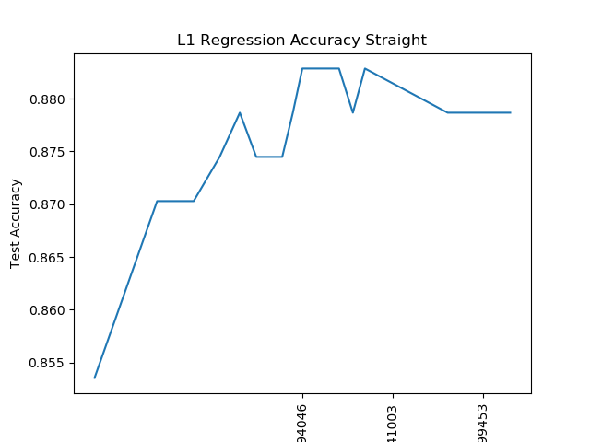
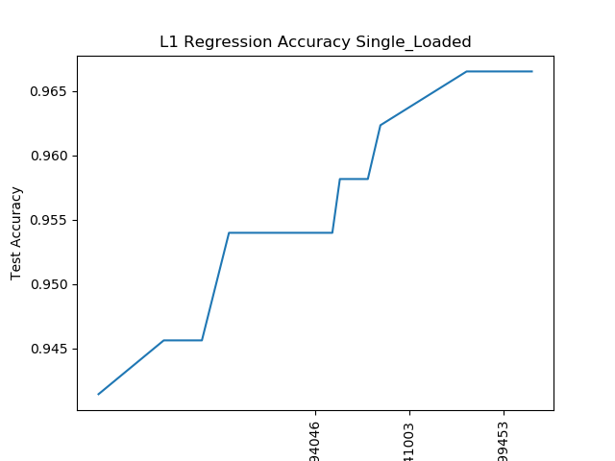
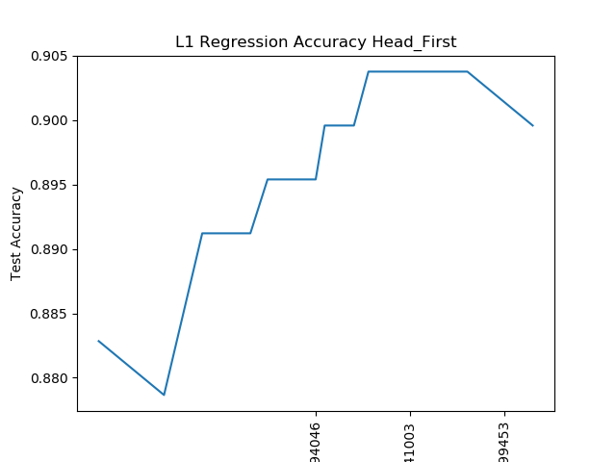
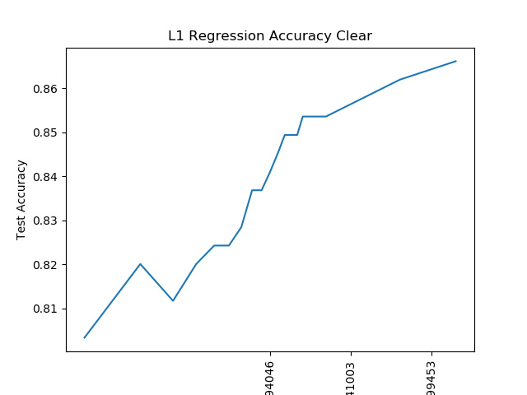
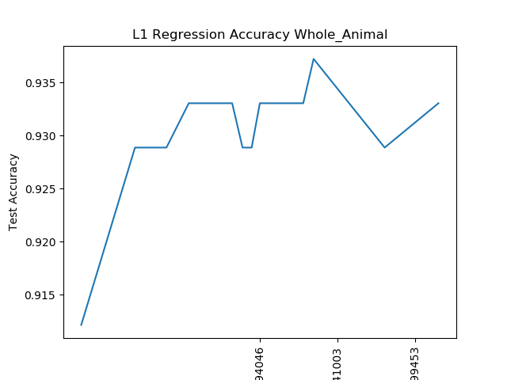
L1 feature selection: sorry these axes are messed up but from left to right, they are values of C
C = [10, 5, 2, 1.75, 1.5, 1.4, 1.3, 1.2, 1.1, 1, .9, .8, .7, .6, .5, .4, .3, .2, .1]

Slide 12
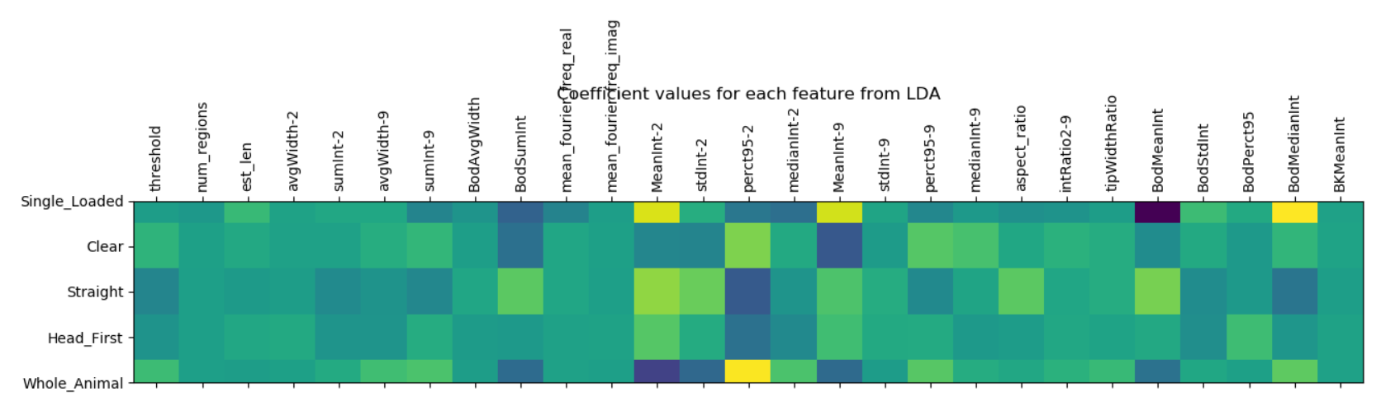
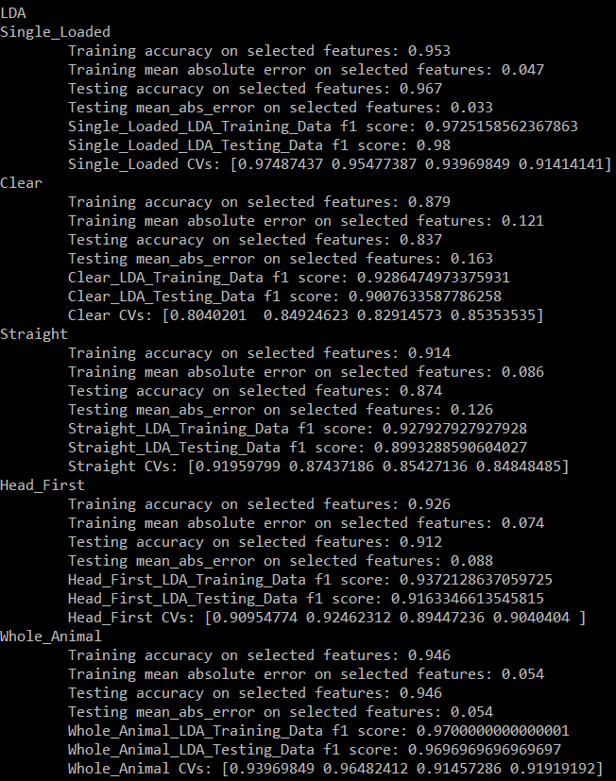
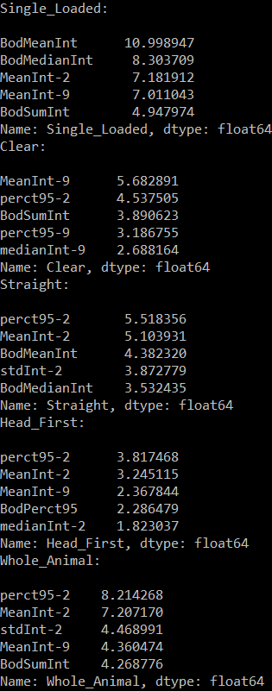
Feature Selection
Standard scaler → LDA
LDA on a binary classification (like ours) will only every project to one dimension
Good training/testing accuracy for all

Slide 13
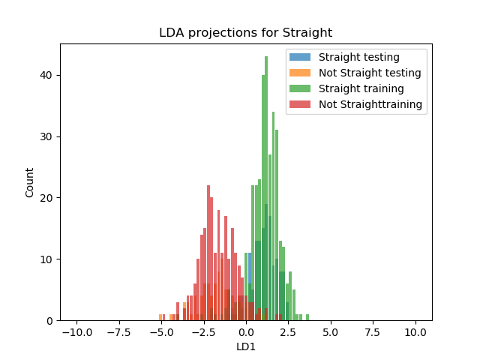
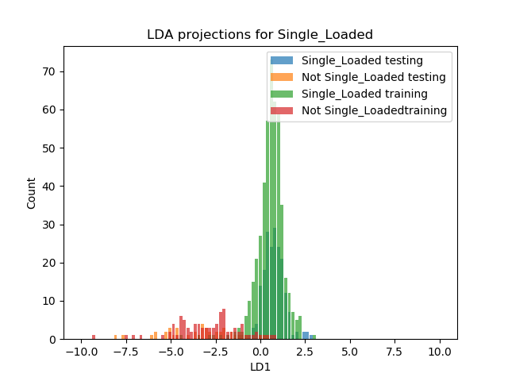
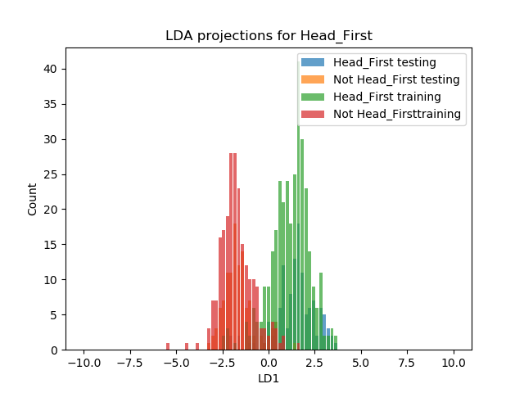
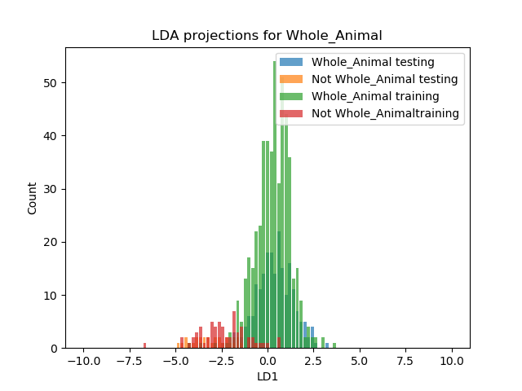
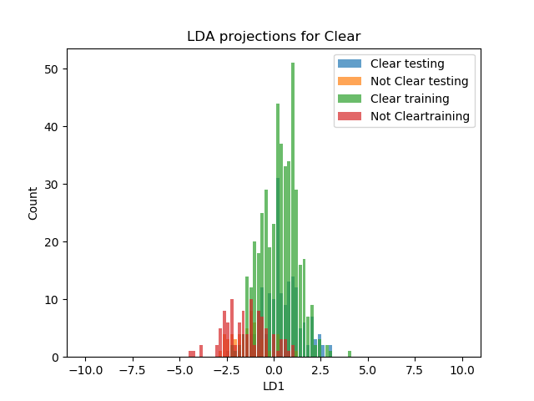
Notes:
Illustrates the distributions of each feature according to the projection done by LDA on the training and testing data.

Slide 14
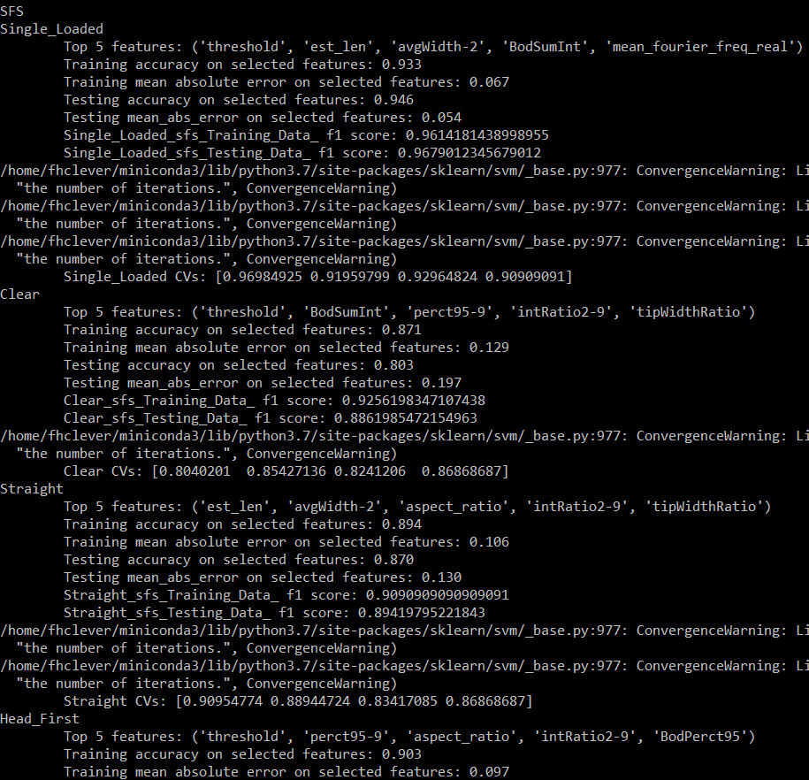
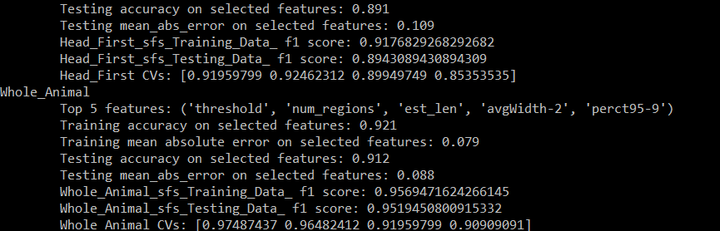
Feature selection
Step forward logistic regression
Good training/testing accuracy for all
Value of C for the logistic regression classifier – may want to change this, currently C = 0.1 but according to the L1 stuff we are doing, we can alter as desired
Notes:
I thought SFS was very interesting because after you perform the SFS, you get a list of features which best model the classification. Then you can do logistic regression on your classification using JUST the recommended features and see how accurate that is. The above screenshot details this. For example, SFS identified avgWidth-1, sumInt-4, sumInt-6, sumInt-7, ad medianInt-1 as the most salient features for the classification of the Single_Loaded feature. When you generate a logistic regression object using solely these features and use it to fit and model your data, then you get very high accuracy for the classification of single loaded vs. multiple loads.
Logistic regression notes:
Solvers: don’t seem to be a big deal as long as you standardize
https://stackoverflow.com/questions/38640109/logistic-regression-python-solvers-definitions
https://towardsdatascience.com/dont-sweat-the-solver-stuff-aea7cddc3451
Max_iter: https://www.naftaliharris.com/blog/visualizing-k-means-clustering/
N_jobs: -1 to use all processors, 1 for a single processor/core, 2 for two processors/cores, etc. – should just affect run time, not the results/outcome
Random_state: make sure this is the same everything you run logistic regression, otherwise your results will be shuffled/outcome will be different – does not matter what you set random_state equal to as long as it’s the same number

Slide 15
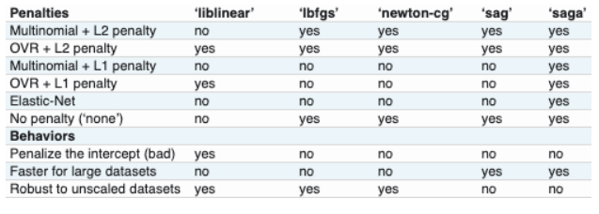




Logistic regression solver types
Notes on logistic regressor solver type
Accuracy by solver before and after data was standardized

Slide 16





Notes:
Performance is the average cross-validated score and the std dev shading represents standard deviation of those cv scores.

Slide 17
Accuracy Metrics for Binary Classifications
Classification accuracy
Logarithmic loss
Confusion matrix accuracy – avoids classification accuracy drawbacks and is very straightforward and intuitive
AUC
ROC-AUC – intuitive, good for when you care equally about both of your classes, but is not so great for heavily imbalanced datasets
PR-AUC
F1 score
Mean Absolute Error – simple calculation
Mean Squared Error
Notes:
Classification accuracy only works well if there is an equal number of samples belonging to each class (same issue with ROC-AUC) and logarithmic loss work well for multiclass classifications, neither of which sound like they would be the best accuracy metric.
F1 score and PR-AUC both focus on TPs and not TNs, but we definitely want to get the TNs counted, so I don’t think that would be right for our data.
Mean squared error won’t give us any more info than mean absolute error because it squares the difference between actual and predicted classifications. This is advantageous for data sets with errors of different sizes because it magnifies the larger errors so that those can be focused on. Having binary classifications means that error for any given point will have the same amount of error, if any at all (we have binary data and binary error, either zero or one). This means there is no point to using MSE because its proclaimed advantage does not apply to us.

Slide 18










Accuracy metrics
Confusion matrix accuracy

Slide 19










Accuracy Metrics
ROC-AUC: graph tpr vs fpr and find AUC. Larger AUC is better because it means higher true positive rate and lower false positive rate for various threshold values.
Notes:
Lots of different thresholds used and a different number of thresholds used for each – why?

Slide 20
Accuracy metrics
Mean absolute error

